Slide 1





MIDDLECHASE
Claim Your City…
0817.873.5450
About Middlechase
Our Estates
Our Homes
Visit Our Site
Downloads
Login
Signup
www.homes.middlechase.com
BUY LAND
BUY HOME
BOOK INSPECTION
www.lands.middlechase.com
Name
Phone Number
Email
1
2
3
4
5
6
Interested Estate
Inspection Date
Preferred Time
Submit

Slide 2


MIDDLECHASE
Claim Your City…
0817.873.5450
About Middlechase
Our Estates
Our Homes
Visit Our Site
Downloads
Login
Signup
HOME OWNERSHIP MADE EASY
Make Your Dream A Reality And Hassle FREE
For Those Who Want Consistent Income
We Provide Instant Access To Rental Income Property Ownership In Choicest Locations
SELECT HOME
VISIT OUR SITE

Slide 3
MIDDLECHASE
Claim Your City…
0817.873.5450
About Middlechase
Our Estates
Our Homes
Reservation
Downloads
Login
Signup
1
CHOOSE YOUR PREFERRED HOME & INTERIOR
2
GET A QUOTE WITH OUR MORTGAGE CALCULATOR
3
TAKE OUR HOME OWNERSHIP EVALUATION
SELECT HOME
VISIT OUR SITE

Slide 4



MIDDLECHASE
Claim Your City…
0817.873.5450
About Middlechase
Our Estates
Our Homes
Reservation
Downloads
Login
Signup
Request A FREE
UBER | TAXIFY
Looking To Visit Our Office Or Our Project Sites
From Your Home To Our Office For Site Inspection
SELECT HOME
VISIT OUR SITE

Slide 5
MIDDLECHASE
Claim Your City…
0817.873.5450
About Middlechase
Our Estates
Our Homes
Reservation
Downloads
Login
Signup
Select Your Preferred
HOME & INTERIOR
Take A Step By Step Guide And Choose
To Your Preference And Taste
SELECT HOME
VISIT OUR SITE

Slide 6
MIDDLECHASE
Claim Your City…
0817.873.5450
About Middlechase
Our Estates
Our Homes
Reservation
Downloads
Login
Signup
Take Advantage Of Our OFFER
EARLY BUYER PROMO
Buy 6 And GET of 1 Apartment FREE Valid Till October 2019
SELECT HOME
VISIT OUR SITE

Slide 7

CHOOSE YOUR HOME & DESIGN
MORTGAGE CALCULATOR
HOME OWNERSHIP EVALUATION
Take A Tour Through Our Listings Whilst You Choose Your Preferred Home And Design
1 of 6
Which of our estates would you want to buy into?
SELECT ONE
SELECT ONE
NEW LAGOS CITY ESTATE, ABIJO, LEKKI
EASTLAND GOLF ESTATE, ABIJO, LEKKI
DREAM PARKS & GARDEN ESTATE, AKODO, IBEJU-LEKKI
EASTHAMPTON ESTATE, ELERANGBE, IBEJU-LEKKI
Victoria-Island
15 min | 12.5KM
Abijo
3 min | 3.2KM
Eleko Junction
Ajah
Awoyaya
35 min | 27.6KM
20 min |18.8KM
NEXT

Slide 8

CHOOSE YOUR HOME & DESIGN
MORTGAGE CALCULATOR
HOME OWNERSHIP EVALUATION
Take A Tour Through Our Listings Whilst You Choose Your Preferred Home And Design
1 of 6
Which of our estates would you want to buy into?
SELECT ONE
SELECT ONE
NEW LAGOS CITY ESTATE, ABIJO, LEKKI
EASTLAND GOLF ESTATE, ABIJO, LEKKI
DREAM PARKS & GARDEN ESTATE, AKODO, IBEJU-LEKKI
EASTHAMPTON ESTATE, ELERANGBE, IBEJU-LEKKI
Victoria-Island
15 min | 12.5KM
Abijo
3 min | 3.2KM
Eleko Junction
Ajah
Awoyaya
35 min | 27.6KM
20 min |18.8KM
NEXT

Slide 9

CHOOSE YOUR HOME & DESIGN
MORTGAGE CALCULATOR
HOME OWNERSHIP EVALUATION
Take A Tour Through Our Listings Whilst You Choose Your Preferred Home And Design
1 of 6
Which of our estates would you want to buy into?
SELECT ONE
SELECT ONE
NEW LAGOS CITY ESTATE, ABIJO, LEKKI
EASTLAND GOLF ESTATE, ABIJO, LEKKI
DREAM PARKS & GARDEN ESTATE, AKODO, IBEJU-LEKKI
EASTHAMPTON ESTATE, ELERANGBE, IBEJU-LEKKI
Ajah
18 min | 11.8KM
Orofun-Akodo
5 min | 3.4KM
Dangote Refinery
Eleko Junction
Lekki FTZ
58 min | 43.3KM
20 min |14.7KM
NEXT

Slide 10

CHOOSE YOUR HOME & DESIGN
MORTGAGE CALCULATOR
HOME OWNERSHIP EVALUATION
Take A Tour Through Our Listings Whilst You Choose Your Preferred Home And Design
ESTATE SELECTION
1 of 6
Which of our estates would you want to buy into?
SELECT ONE
SELECT ONE
NEW LAGOS CITY ESTATE, ABIJO, LEKKI
EASTLAND GOLF ESTATE, ABIJO, LEKKI
DREAM PARKS & GARDEN ESTATE, AKODO, IBEJU-LEKKI
EASTHAMPTON ESTATE, ELERANGBE, IBEJU-LEKKI
Ajah
15 min | 12.5KM
Elerangbe
3 min | 3.2KM
Epe
Eleko Junction
Lekki Airport
35 min | 27.6KM
20 min |18.8KM
NEXT

Slide 11
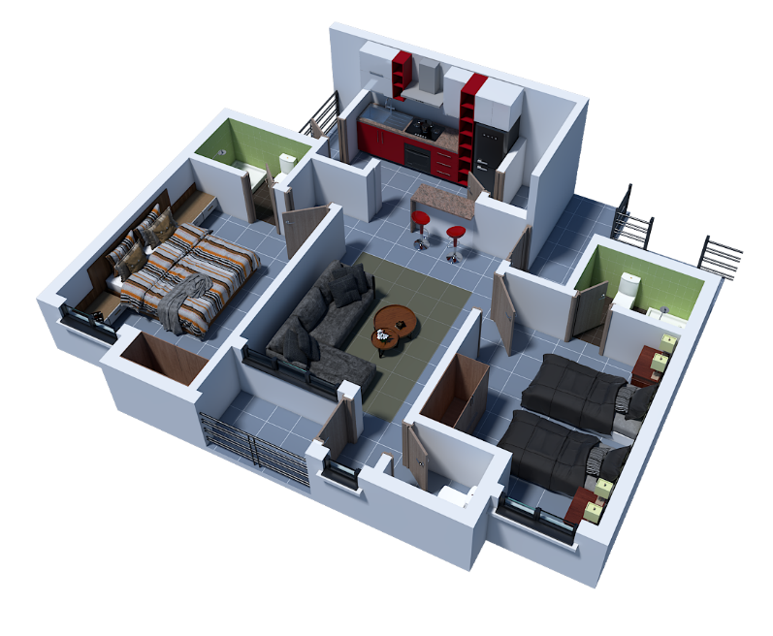
CHOOSE YOUR HOME & DESIGN
MORTGAGE CALCULATOR
HOME OWNERSHIP EVALUATION
Take A Tour Through Our Listings Whilst You Choose Your Preferred Home And Design
ESTATE SELECTION | NEW LAGOS CITY | COURT A
2 of 7
What apartment type would you like? (Note that your choice of apartment would influence your block and floor level)
SELECT HOME TYPE
SELECT HOME TYPE
2 BEDROOM APARTMENT
3 BEDROOM APARTMENT
3 BEDROOM PENTHOUSE SUITE
PREVIOUS | NEXT

Slide 12
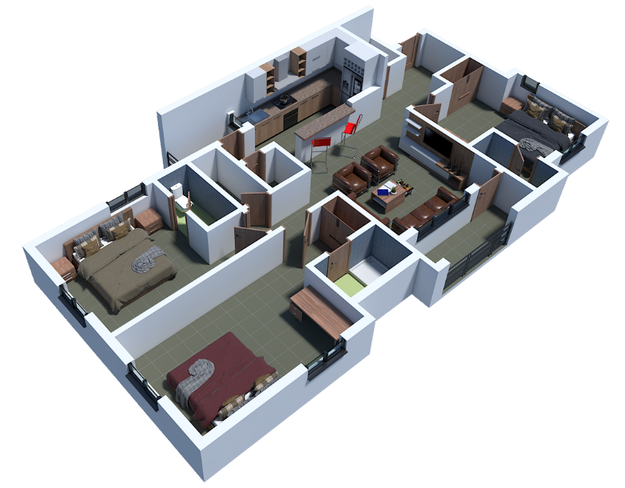
CHOOSE YOUR HOME & DESIGN
MORTGAGE CALCULATOR
HOME OWNERSHIP EVALUATION
Take A Tour Through Our Listings Whilst You Choose Your Preferred Home And Design
ESTATE SELECTION | NEW LAGOS CITY | COURT A
2 of 7
What apartment type would you like? (Note that your choice of apartment would influence your block and floor level)
SELECT HOME TYPE
SELECT HOME TYPE
2 BEDROOM APARTMENT
3 BEDROOM APARTMENT
3 BEDROOM PENTHOUSE SUITE
PREVIOUS | NEXT

Slide 13
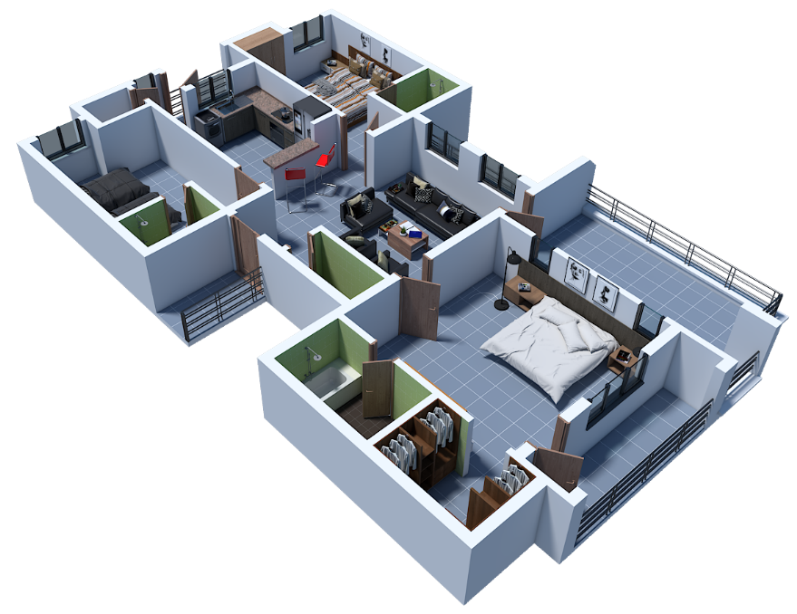
CHOOSE YOUR HOME & DESIGN
MORTGAGE CALCULATOR
HOME OWNERSHIP EVALUATION
Take A Tour Through Our Listings Whilst You Choose Your Preferred Home And Design
ESTATE SELECTION | NEW LAGOS CITY | COURT A
2 of 7
What apartment type would you like? (Note that your choice of apartment would influence your block and floor level)
SELECT HOME TYPE
SELECT HOME TYPE
2 BEDROOM APARTMENT
3 BEDROOM APARTMENT
3 BEDROOM PENTHOUSE SUITE
PREVIOUS | NEXT

Slide 14
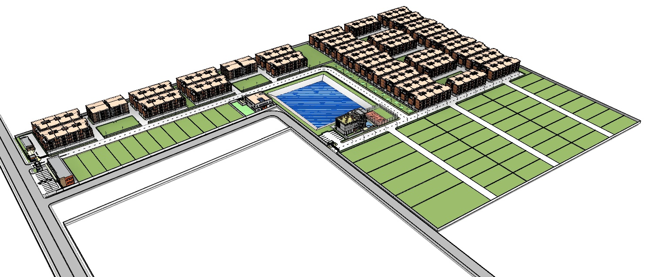
CHOOSE YOUR HOME & DESIGN
MORTGAGE CALCULATOR
HOME OWNERSHIP EVALUATION
Take A Tour Through Our Listings Whilst You Choose Your Preferred Home And Design
ESTATE SELECTION | NEW LAGOS CITY
3 of 7
Court C
What neighborhood would you like?
Court D
Court B
Court E
SELECT PREFERRED COURT
COURT A (Sold Out)
COURT B
COURT C
COURT D
COURT E
SELECT PREFERRED COURT
Court A
SELECT BLOCK NUMBER
SELECT BLOCK NUMBER
BLOCK 01
BLOCK 02
BLOCK 03
BLOCK 04
BLOCK 05
BLOCK 06
BLOCK 07
BLOCK 08
PREVIOUS | NEXT

Slide 15
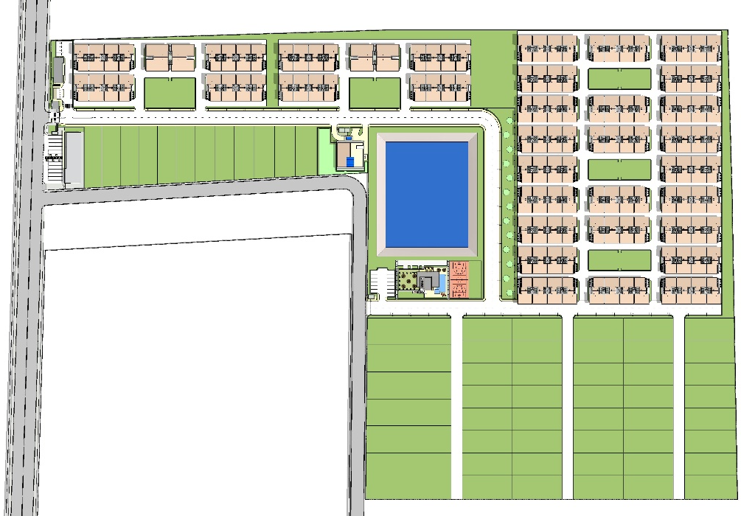
CHOOSE YOUR HOME & DESIGN
MORTGAGE CALCULATOR
HOME OWNERSHIP EVALUATION
Take A Tour Through Our Listings Whilst You Choose Your Preferred Home And Design
ESTATE SELECTION | NEW LAGOS CITY | COURT A
2 of 7
What apartment type and block would you like? (Note that your choice of apartment would influence your block and floor level)
01
02
03
01
02
03
01
02
03
05
04
05
04
08
04
07
06
05
SELECT HOME TYPE
01
02
03
08
04
07
06
05
SELECT HOME TYPE
2 BEDROOM APARTMENT
3 BEDROOM APARTMENT
3 BEDROOM PENTHOUSE SUITE
01
02
03
08
04
07
06
05
PREVIOUS | NEXT

Slide 16
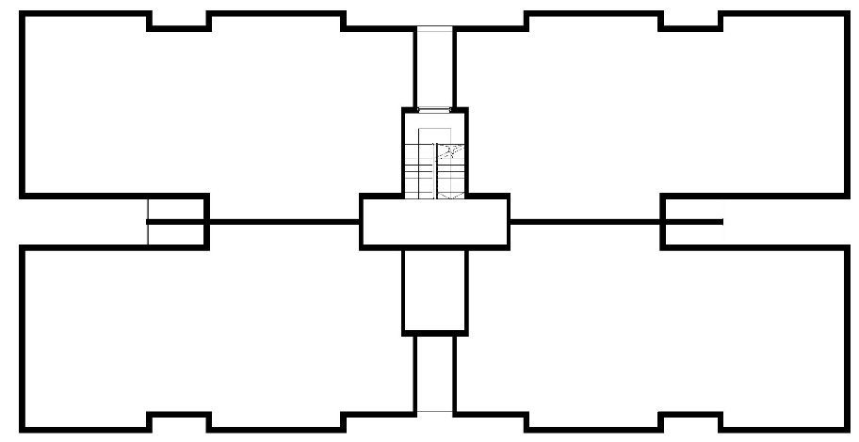
CHOOSE YOUR HOME & DESIGN
MORTGAGE CALCULATOR
HOME OWNERSHIP EVALUATION
Take A Tour Through Our Listings Whilst You Choose Your Preferred Home And Design
4 of 7
Select Your Floor And Apartment Home
SELECT YOUR FLOOR
1ST FLOOR
2ND FLOOR
3RD FLOOR
SELECT YOUR FLOOR
THIRD FLOOR
APARTMENT
01
APARTMENT
02
SELECT YOUR APARTMENT
SECOND FLOOR
SELECT YOUR APARTMENT
APARTMENT 01
APARTMENT 02
APARTMENT 03
APARTMENT 04
APARTMENT 05
APARTMENT 06
APARTMENT 07
APARTMENT 08
FIRST FLOOR
APARTMENT
03
APARTMENT
04
PARKING
PREVIOUS | NEXT

Slide 17
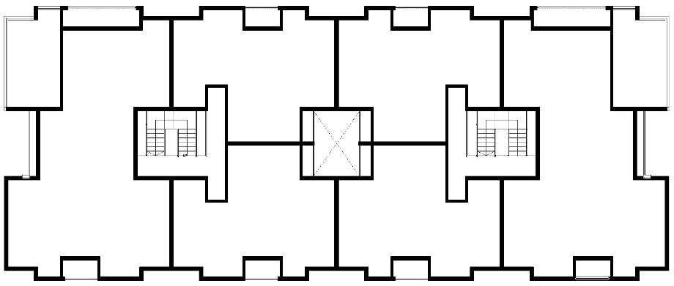
CHOOSE YOUR HOME & DESIGN
MORTGAGE CALCULATOR
HOME OWNERSHIP EVALUATION
Take A Tour Through Our Listings Whilst You Choose Your Preferred Home And Design
4 of 7
Select Your Floor And Apartment Home
SELECT YOUR FLOOR
1ST FLOOR
2ND FLOOR
3RD FLOOR
SELECT YOUR FLOOR
THIRD FLOOR
APARTMENT
02
APARTMENT
03
SELECT YOUR APARTMENT
SECOND FLOOR
SELECT YOUR APARTMENT
APARTMENT 01
APARTMENT 02
APARTMENT 03
APARTMENT 04
APARTMENT 05
APARTMENT 06
APARTMENT 07
APARTMENT 08
FIRST FLOOR
APARTMENT
01
APARTMENT
04
APARTMENT
05
APARTMENT
06
PARKING
PREVIOUS | NEXT

Slide 18
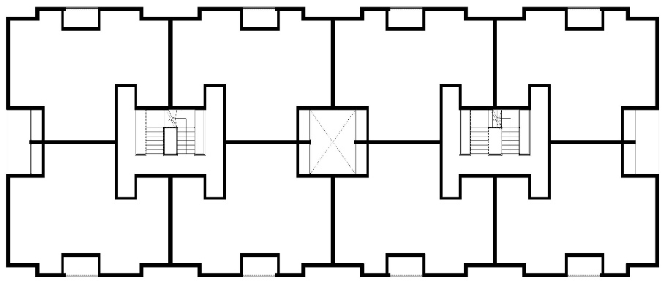
CHOOSE YOUR HOME & DESIGN
MORTGAGE CALCULATOR
HOME OWNERSHIP EVALUATION
Take A Tour Through Our Listings Whilst You Choose Your Preferred Home And Design
4 of 7
Select Your Floor And Apartment Home
SELECT YOUR FLOOR
1ST FLOOR
2ND FLOOR
3RD FLOOR
SELECT YOUR FLOOR
THIRD FLOOR
APARTMENT
01
APARTMENT
02
APARTMENT
03
APARTMENT
04
SELECT YOUR APARTMENT
SECOND FLOOR
SELECT YOUR APARTMENT
APARTMENT 01
APARTMENT 02
APARTMENT 03
APARTMENT 04
APARTMENT 05
APARTMENT 06
APARTMENT 07
APARTMENT 08
FIRST FLOOR
APARTMENT
05
APARTMENT
06
APARTMENT
07
APARTMENT
08
PARKING
PREVIOUS | NEXT

Slide 19
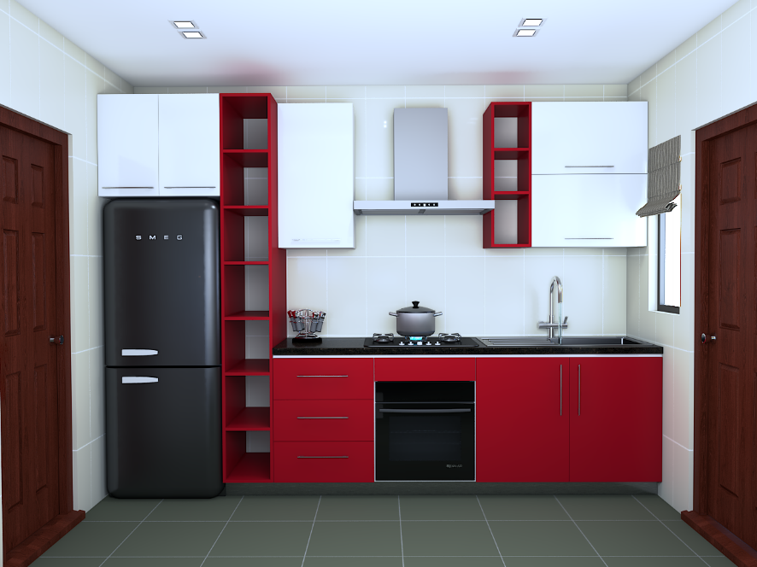

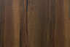
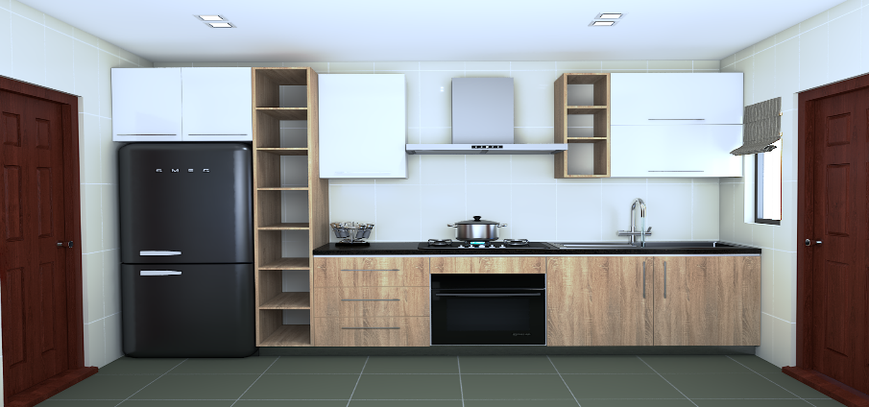
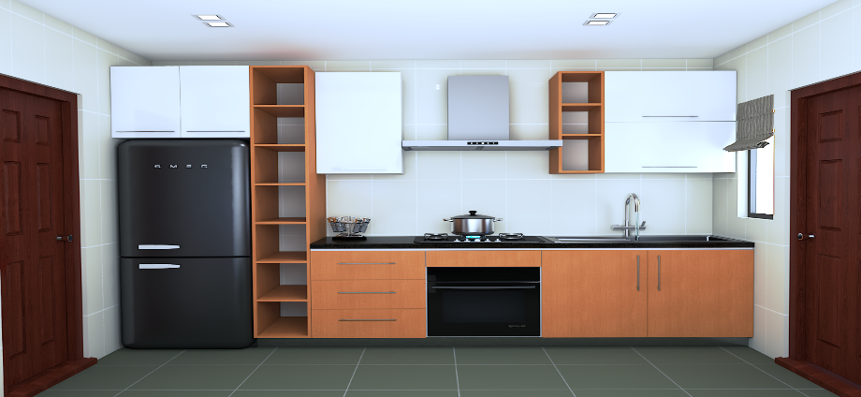
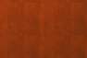
CHOOSE YOUR HOME & DESIGN
MORTGAGE CALCULATOR
HOME OWNERSHIP EVALUATION
Take A Tour Through Our Listings Whilst You Choose Your Preferred Home And Design
5 of 7
Select Your Kitchen Theme
Red Cabinet
Chocolate Cabinet
Dark Brown Cabinet
Light Brown Cabinet
Orange Cabinet
PREVIOUS | NEXT

Slide 20
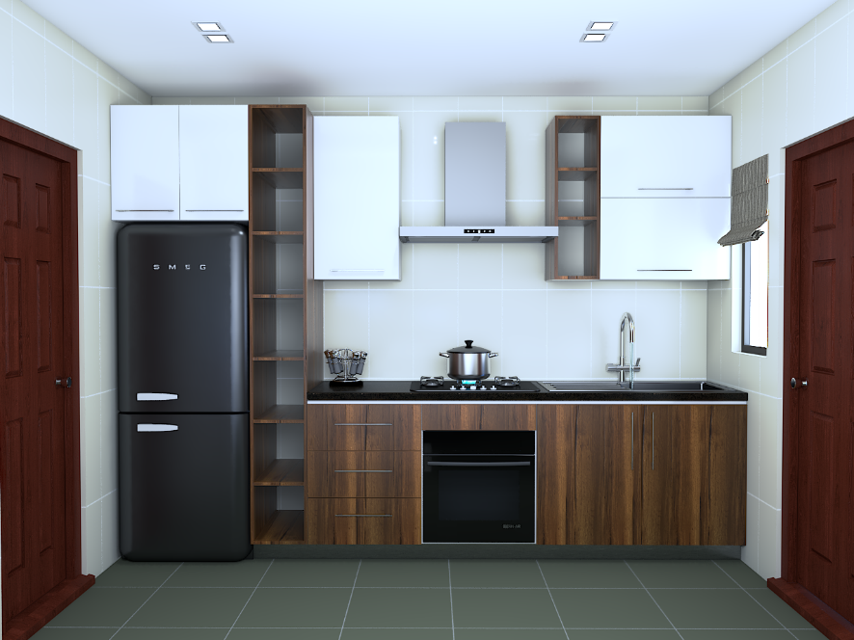
CHOOSE YOUR HOME & DESIGN
MORTGAGE CALCULATOR
HOME OWNERSHIP EVALUATION
Take A Tour Through Our Listings Whilst You Choose Your Preferred Home And Design
5 of 7
Select Your Kitchen Theme
Red Cabinet
Chocolate Cabinet
Dark Brown Cabinet
Light Brown Cabinet
Orange Cabinet
PREVIOUS | NEXT

Slide 21

CHOOSE YOUR HOME & DESIGN
MORTGAGE CALCULATOR
HOME OWNERSHIP EVALUATION
Take A Tour Through Our Listings Whilst You Choose Your Preferred Home And Design
5 of 7
Select Your Kitchen Theme
Red Cabinet
Chocolate Cabinet
Dark Brown Cabinet
Light Brown Cabinet
Orange Cabinet
PREVIOUS | NEXT

Slide 22

CHOOSE YOUR HOME & DESIGN
MORTGAGE CALCULATOR
HOME OWNERSHIP EVALUATION
Take A Tour Through Our Listings Whilst You Choose Your Preferred Home And Design
5 of 7
Select Your Kitchen Theme
Red Cabinet
Chocolate Cabinet
Dark Brown Cabinet
Light Brown Cabinet
Orange Cabinet
PREVIOUS | NEXT

Slide 23

CHOOSE YOUR HOME & DESIGN
MORTGAGE CALCULATOR
HOME OWNERSHIP EVALUATION
Take A Tour Through Our Listings Whilst You Choose Your Preferred Home And Design
5 of 7
Select Your Kitchen Theme
Red Cabinet
Chocolate Cabinet
Dark Brown Cabinet
Light Brown Cabinet
Orange Cabinet
PREVIOUS | NEXT

Slide 24
CHOOSE YOUR HOME & DESIGN
MORTGAGE CALCULATOR
HOME OWNERSHIP EVALUATION
Take A Tour Through Our Listings Whilst You Choose Your Preferred Home And Design
6 of 7
Select Your Floor Tile Theme
Cream Shades
Grey Shades
Black Shades
Brown Shades
Blue Shades
PREVIOUS | NEXT

Slide 25
CHOOSE YOUR HOME & DESIGN
MORTGAGE CALCULATOR
HOME OWNERSHIP EVALUATION
Take A Tour Through Our Listings Whilst You Choose Your Preferred Home And Design
6 of 7
Select Your Floor Tile Theme
Cream Shades
Grey Shades
Black Shades
Brown Shades
Blue Shades
PREVIOUS | NEXT

Slide 26
CHOOSE YOUR HOME & DESIGN
MORTGAGE CALCULATOR
HOME OWNERSHIP EVALUATION
Take A Tour Through Our Listings Whilst You Choose Your Preferred Home And Design
6 of 7
Select Your Floor Tile Theme
Cream Shades
Grey Shades
Black Shades
Brown Shades
Blue Shades
PREVIOUS | NEXT

Slide 27
CHOOSE YOUR HOME & DESIGN
MORTGAGE CALCULATOR
HOME OWNERSHIP EVALUATION
Take A Tour Through Our Listings Whilst You Choose Your Preferred Home And Design
6 of 7
Select Your Floor Tile Theme
Cream Shades
Grey Shades
Black Shades
Brown Shades
Blue Shades
PREVIOUS | NEXT

Slide 28
CHOOSE YOUR HOME & DESIGN
MORTGAGE CALCULATOR
HOME OWNERSHIP EVALUATION
Take A Tour Through Our Listings Whilst You Choose Your Preferred Home And Design
6 of 7
Select Your Floor Tile Theme
Cream Shades
Grey Shades
Black Shades
Brown Shades
Blue Shades
PREVIOUS | NEXT

Slide 29
CHOOSE YOUR HOME & DESIGN
MORTGAGE CALCULATOR
HOME OWNERSHIP EVALUATION
Take A Tour Through Our Listings Whilst You Choose Your Preferred Home And Design
7 of 7
Let’s Get To Know You
FIRST NAME
SURNAME
AGE RANGE
MOBILE PHONE NUMBER
WHATSAPP NUMBER
EMAIL
AGE RANGE
25 – 29
30 – 34
35 – 39
40 – 44
45 – 49
50 and above
PREVIOUS SUBMIT

Slide 30
CHOOSE YOUR HOME & DESIGN
MORTGAGE CALCULATOR
HOME OWNERSHIP EVALUATION
Make Use Of Our Quick Calculator To Know How Much You Would Pay Monthly
HOUSE TYPE
₦
INITIAL DEPOSIT
DURATION
CALCULATE
Own A 2 Bedroom Apartment At A Total Cost Of ₦10,500,000
With Initial Deposit of ₦5,200,000 And ₦1,767,000.00 Monthly Mortgage Payment Plan
For A Duration Of 3 Months
2 Bedroom Apartment
OUTRIGHT - ₦10,500,000
3 Bedroom Penthouse
OUTRIGHT - ₦15,000,000
3 Bedroom Apartment
OUTRIGHT - ₦12,000,000
Payment Plan | Down Payment | Monthly Payment
3 Months | ₦5,200,000 | ₦1,767,000
6 Months | ₦4,000,000 | ₦1,084,000
9 Months | ₦4,000,000 | ₦722,223
12 Months | ₦4,000,000 | ₦541,667
Payment Plan | Down Payment | Monthly Payment
3 Months | ₦6,000,000 | ₦3,000,000
6 Months | ₦4,000,000 | ₦1,834,000
9 Months | ₦4,000,000 | ₦1,223,000
12 Months | ₦4,000,000 | ₦916,667
Payment Plan | Down Payment | Monthly Payment
3 Months | ₦6,000,000 | ₦3,000,000
6 Months | ₦4,000,000 | ₦1,834,000
9 Months | ₦4,000,000 | ₦1,223,000
12 Months | ₦4,000,000 | ₦916,667

Slide 31
CHOOSE YOUR HOME & DESIGN
MORTGAGE CALCULATOR
HOME OWNERSHIP EVALUATION
Take a quick survey and get evaluation which gives you an eligibility for our homes
1 of 6
Kindly Provide Your Phone Number Or Email To Proceed, It’ll Only Take 2 Minutes.
PHONE NUMBER / EMAIL
START
Successful
Welcome! JAMES ADEFUYE
Please Proceed To Take Your Evaluation Now.
NEXT
Unsuccessful
Unfortunately there is no such information.
Click next to proceed

Slide 32
CHOOSE YOUR HOME & DESIGN
MORTGAGE CALCULATOR
HOME OWNERSHIP EVALUATION
Take a quick survey and get evaluation which gives you an eligibility for our homes
1 of 6
Let’s Get To Know You
FIRST NAME
SURNAME
AGE RANGE
MOBILE PHONE NUMBER
WHATSAPP NUMBER
EMAIL
NEXT
AGE RANGE
25 – 29
30 – 34
35 – 39
40 – 44
45 – 49
50 and above

Slide 33
CHOOSE YOUR HOME & DESIGN
MORTGAGE CALCULATOR
HOME OWNERSHIP EVALUATION
Take a quick survey and get evaluation which gives you an eligibility for our homes
2 of 6
What's Your Job Status And CashFlow Details
EMPLOYMENT STATUS
INDUSTRY
MONTHLY SALARY RANGE
DURATION OF YEARS WORKING
ARE YOU SERVICING DEBT/ LOAN
PREVIOUS | NEXT
EMPLOYMENT STATUS
EMPLOYED | BUSINESS OWNER | BOTH
INDUSTRY
BANKING & FINANCE | BUILDING CONSTRUCTION |
MONTHLY SALARY RANGE
N150,000 - N250,000 | N260,000 - N350,000 | N360,000 - N490,000 | N500,000 - N900,000 | N1,000,000 and above

Slide 34
CHOOSE YOUR HOME & DESIGN
MORTGAGE CALCULATOR
HOME OWNERSHIP EVALUATION
Take a quick survey and get evaluation which gives you an eligibility for our homes
3 of 6
What Home Ownership Structure Are You Subscribing To?
Sole Ownership
Dual-Ownership
Co-Ownership
CUMMULATIVE MONTHLY SALARY RANGE
YOU ARE BUYING TO?
PREVIOUS | NEXT
MONTHLY SALARY RANGE
N150,000 - N250,000 | N260,000 - N350,000 | N360,000 - N490,000 | N500,000 - N900,000 | N1,000,000 – N2,000,000 | N2,100,000 and above

Slide 35
CHOOSE YOUR HOME & DESIGN
MORTGAGE CALCULATOR
HOME OWNERSHIP EVALUATION
Take a quick survey and get evaluation which gives you an eligibility for our homes
4 of 6
Current Location And Accommodation Information
Lagos Island
Lagos Mainland
Outside Lagos
Outside Nigeria
DO YOU OWN A HOUSE
DO YOU RESIDE IN A RENTED APARTMENT
TENTATIVE POSSESSION TIME
PREVIOUS | NEXT
MONTHLY SALARY RANGE
N150,000 - N250,000 | N260,000 - N350,000 | N360,000 - N490,000 | N500,000 - N900,000 | N1,000,000 – N2,000,000 | N2,100,000 and above

Slide 36
CHOOSE YOUR HOME & DESIGN
MORTGAGE CALCULATOR
HOME OWNERSHIP EVALUATION
Take a quick survey and get evaluation which gives you an eligibility for our homes
5 of 6
Home Payment Information
Outright Payment
Instalment Payment
Mortgage payment
PAYMENT DURATION
YOUR PREFERRED MONTHLY PAYMENT
PREVIOUS | NEXT
PAYMENT DURATION
12 MONTHS | 18 MONTHS | 24 MONTHS | 36 MONTHS (Instalment)
48 MONTHS | 60 MONTHS | 84 MONTHS | 120 MONTHS (Mortgage)
YOUR PREFERRED MONTHLY PAYMENT
N75,000 – N140,000 | N150,000 - N250,000 | N260,000 - N350,000 | N360,000 - N490,000 | N500,000 - N900,000 | N1,000,000 and above

Slide 37
CHOOSE YOUR HOME & DESIGN
MORTGAGE CALCULATOR
HOME OWNERSHIP EVALUATION
Take a quick survey and get evaluation which gives you an eligibility for our homes
6 of 6
Home Preference And Location
Detached House
Semi-Detached House
Terrace/ Townhouse
Flat/ Apartment
BEDROOM
PREFERRED LOCATION
PREVIOUS SUBMIT
BEDROOM
2 BEDROOMS | 3 BEDROOMS | 4 BEDROOMS | 5 BEDROOM
PREFERRED LOCATION
NEW LAGOS CITY ESTATE, ABIJO, LEKKI
EASTLAND GOLF ESTATE, ABIJO, LEKKI
DREAM PARKS & GARDEN ESTATE, AKODO, IBEJU-LEKKI
EASTHAMPTON ESTATE, ELERANGBE, IBEJU-LEKKI

Slide 38
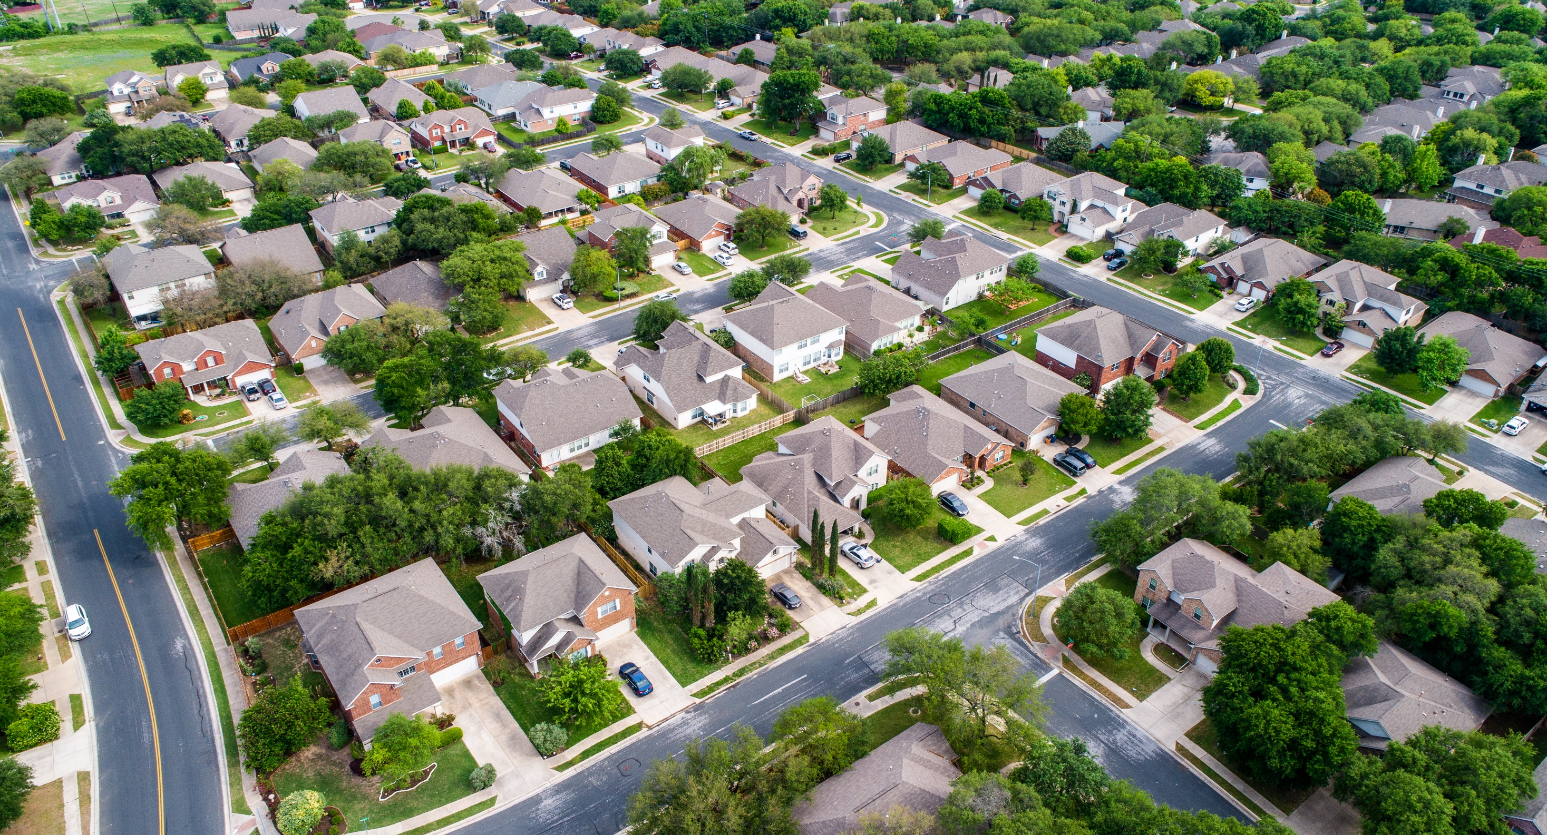




About MIDDLECHASE
Our Vision
Our Mission
Our Team
Property Baron
Claim Your Property Today
One of the most well-established companies in the real estate industry, Middlechase Property Limited provides families and investors with opportunities to invest in handpicked Nigerian property investments in today's top performing asset classes ranging from residential to commercial to mixed-use developments.
As the company has grown, markets have changed and MIDDLECHASE is the leading rental income developer in Africa dedicated to non-traditional residential development, innovatively designed to meet the needs of today’s astute investor and modern family.
Middlechase… Everyday Cashflow
359
CLIENTS
10,000
HOMES
4
COMMUNITIES
4,576
SITE VISITORS
The Fastest Growing Industry Leader In Rental Property Sales In Nigeria…

Slide 39
What Is AMH?
Our Vision
Our Mission
Our Team
Property Baron
Our Vision
As the leading inventor of excellently crafted community and recognised industry leader in asset development and management as MIDDLECHASE is to make first-time home buyers comfortable, happy and worry-free both during the home buying process and even after their closings and to be reputable Real Estate Sales Consultant for first-time home buyers and rental-income property, effectively eliminating competition within the market.
359
CLIENTS
10,000
HOMES
4
COMMUNITIES
4,576
SITE VISITORS
The Fastest Growing Industry Leader In Rental Property Sales In Nigeria…

Slide 40
What Is AMH?
Our Vision
Our Mission
Our Team
Property Baron
For those who want CONSISTENT INCOME, Middlechase provides instant access to rental income property ownership with the power to choose your preference.
To bridge the obvious gap between you and your dream of owing a home or consistently generating rental income from real estate which is a foolproof CashFlow and guaranteed system to help our clients hedge against inflation
359
CLIENTS
10,000
HOMES
4
COMMUNITIES
4,576
SITE VISITORS
The Fastest Growing Industry Leader In Rental Property Sales In Nigeria…

Slide 41



What Is AMH?
Our Vision
Our Mission
Our Team
Property Baron
Head of Sales
Sales Officer
Sales Officer
Change On Mouse Over
Esther
OKENWA
Email
esther@middlechase.com
Phone
0706 212 4157
Ayooluwa
OLANIYI
Email
ayo@middlechase.com
Phone
0818 657 7704
Oyeyemi
ODEYEMI
Email
yemi@middlechase.com
Phone
0700 000 0000
359
CLIENTS
10,000
HOMES
4
COMMUNITIES
4,576
SITE VISITORS
The Fastest Growing Industry Leader In Rental Property Sales In Nigeria…
Head of Sales
Sales Officer
Sales Officer

Slide 42

What Is AMH?
Our Vision
Our Mission
Our Team
Property Baron
Earn As Much As 10% When You Refer Us To A Home Buyer!
Property Baron Network, an opportunity yet untapped is our investment program designed for our customers and realtors that want to build CashFlow.
Join PROPERTY BARON NETWORK Powered by Arkbridge Integrated Limited as our way to ‘Make Your Network Your Net Worth’ The process is transparent, accessible and informative.
Partner With Us As A Realtor Today And Enjoy The Benefits Of CashFlow and Rental Income
Join Network Now
www.pbn.arkbridge.com.ng
359
CLIENTS
10,000
HOMES
4
COMMUNITIES
4,576
SITE VISITORS
The Fastest Growing Industry Leader In Rental Property Sales In Nigeria…

Slide 43

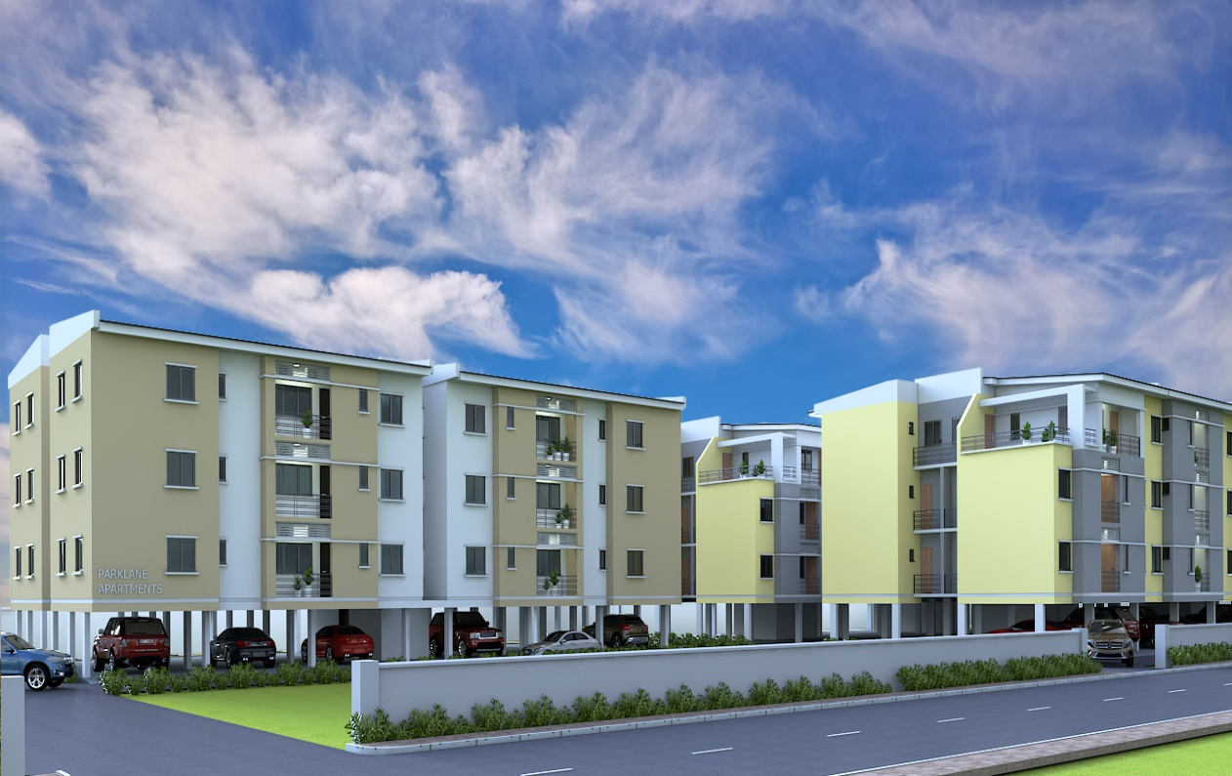
Our APARTMENTS
Income Comes First…
Africa's Inventor of Excellently Crafted Communities
Bespoke developments
Highly desirable locations
First-class service
Innovative investment solutions
Middlechase is an award winning international property developer, specializing in emerging property income markets and is currently pioneering niche and iconic projects in Nigeria and Africa.
The company has a proud history of over 9 years' experience and success, and continues to produce and develop bespoke property investments in some of the Nigeria's most desirable locations.
With its expertise in emerging property income markets, Middlechase has recognized the unparalleled investment opportunities in Nigeria and Africa, and is proud to offer clients innovative off-plan properties in these sought-after regions, as well as unrivalled investment services and pioneering products.
With a passion for excellence and a commitment to affordable luxury development in all areas of construction, design, finish and service, Middlechase is leading the way for innovative and affordable property development in Lagos, Ogun etc., providing its clients with luxury properties for a secure and profitable investment

Slide 44




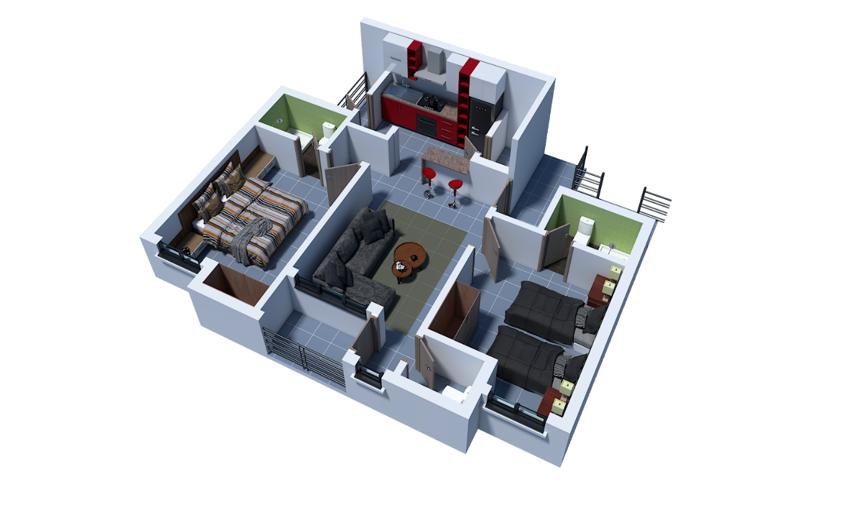

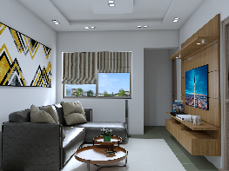
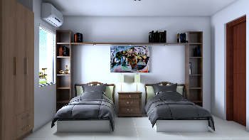
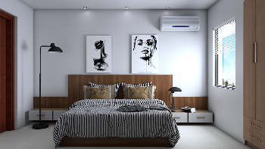
2 Bedroom Apartment
2 Bedrooms
2 Bathrooms
3 Toilets
2 Parking Lots
Space | Area | Size
Living Room | 17m² | 10’ X 15’
Kitchen | 7m² | 7’ X 11’
Pantry | 2m² | 3’ X 6’
Master Bedroom En-suite | 15.3m² | 10’ X 13’
Bedroom 2 En-suite | 13.8m² | 10’ X 13’
Visitor’s Toilet | 1.4m² | 3’ X 4’
Balcony | 2.4m² | 7’ X 4’

Slide 45

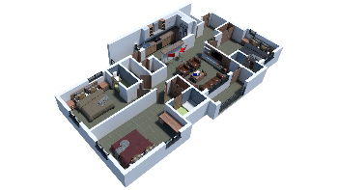
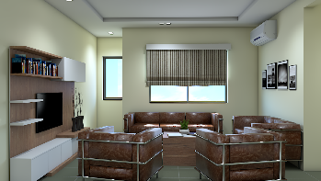
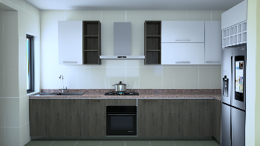
3 Bedroom Apartment
3 Bedrooms
3 Bathrooms
4 Toilets
3 Parking Lots
Space | Area | Size
Living Room | 19m² | 13’ X 15’
Ante Room | 6m² | 4’ X 11’
Kitchen | 9m² | 6’ X 13’
Pantry | 1.4m² | 4’ X 4’
Box Room | 2.4m² | 4’ X 6’
Master Bedroom | 16m² | 11’ X 16’
Master Toilet | 3m² | 4’ X 7’
Walk-In-Closet | 3m² | 4’ X 7’
Bedroom 2 En-suite | 16.3m² | 13’ X 13’
Bedroom 3 En-suite | 16.3m² | 11’ X 12’
Visitor’s Toilet | 2m² | 3’ X 7’
Balcony | 3m² | 3’ X 13’

Slide 46

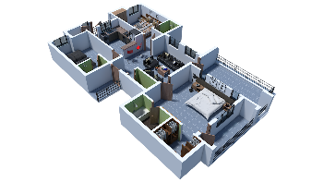
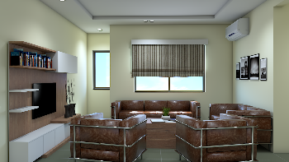
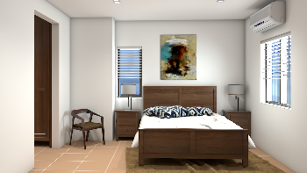
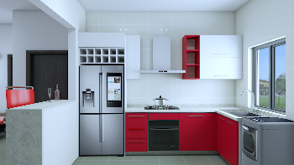
3 Bedroom Penthouse Suite
3 Bedrooms
3 Bathrooms
4 Toilets
2 Parking Lots
Space | Area | Size
Living Room | 24m² | 13’ X 15’
Kitchen | 12m² | 10’ X 11’
Pantry | 1.4m² | 3’ X 4’
Master Bedroom | 22m² | 15’ X 15’
Master Toilet | 4.5m² | 5’ X 9’
Walk-In-Closet | 4m² | 5’ X 8’
Master Balcony | 5m² | 3’ X 15’
Bedroom 2 En-suite | 15.3m² | 10’ X 13’
Bedroom 3 En-suite | 17m² | 11’ X 12’
Visitor’s Toilet | 2m² | 3’ X 7’
Balcony | 17m² | 11’ X 17’

Slide 47

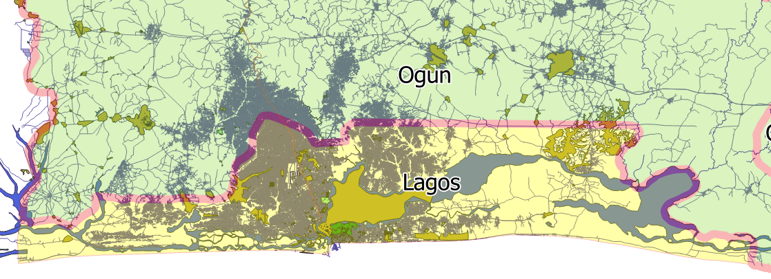
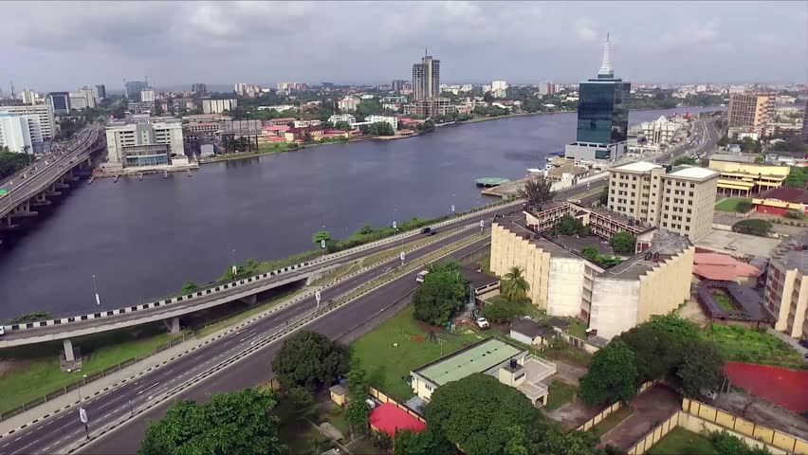
BOOK A VISIT FOR FREE
Are You Considering A Site Inspection Or Office Visit
Request A Free Ride From Your Home Or Office To Our Office And Also To The Site For FREE
Book Now
Name
Phone Number
Email
1
2
3
4
5
6
Interested Estate
Inspection Date
Preferred Time
Submit
DOWNLOADS
Application Form | Project Schedule | Brochure | FAQ

